Slide 1


GeoEmbed
Leveraging geoscience company data with embeddings
EAGE: Hackathon
Coding to net-zero: AI for energy-efficient future

Slide 2





GeoEmbed: Meet the team
Giuseppe Amendola
Geophysicist
Matthieu Guillouet
AI and software developer

Slide 3
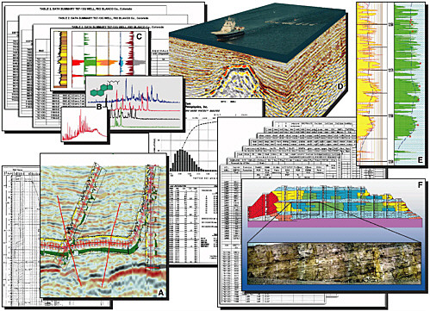
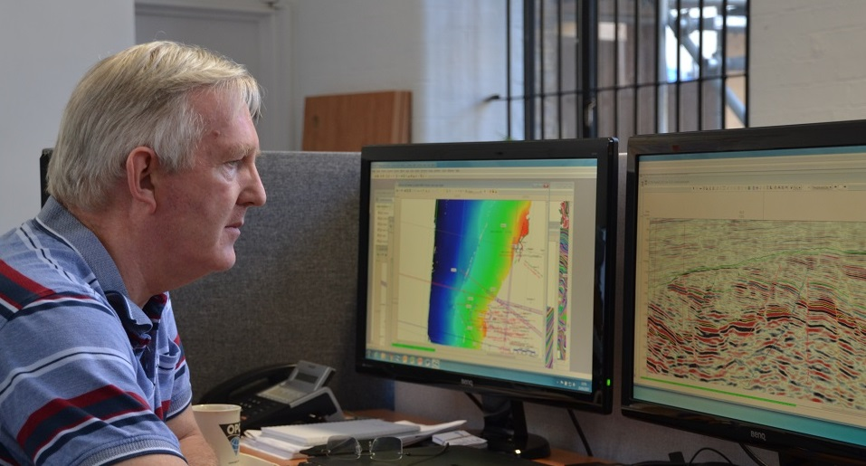
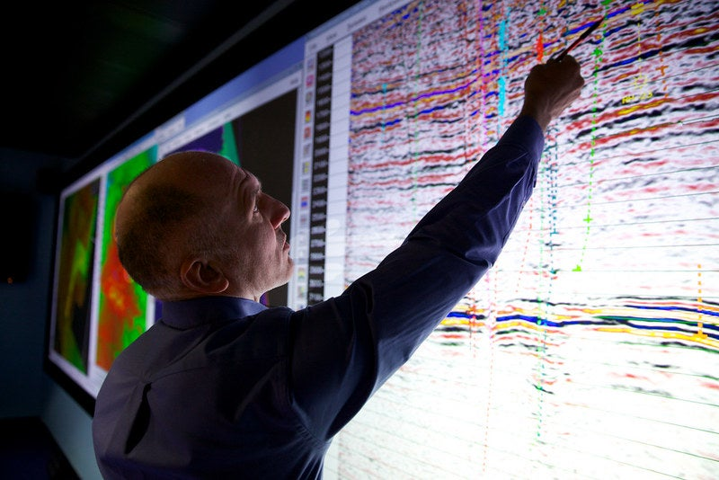
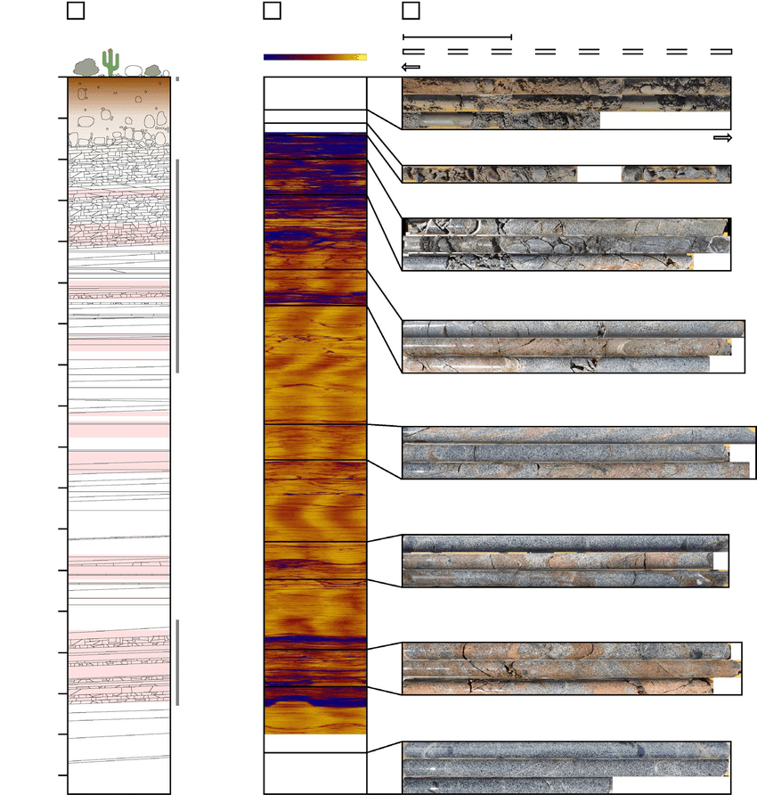
The problem
Geoscience data interpretation might be challenging when dealing with several type of data

Slide 4

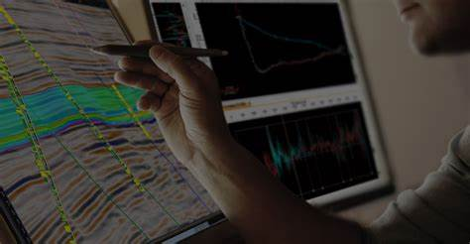
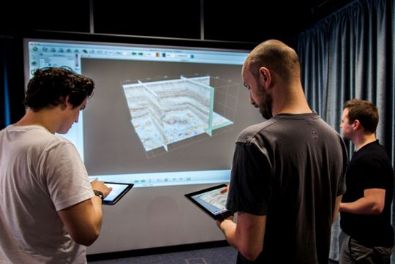
The solution
GeoEmbed
AI agent that can leverage all the company data for efficient geoscience data interpretation

Slide 5
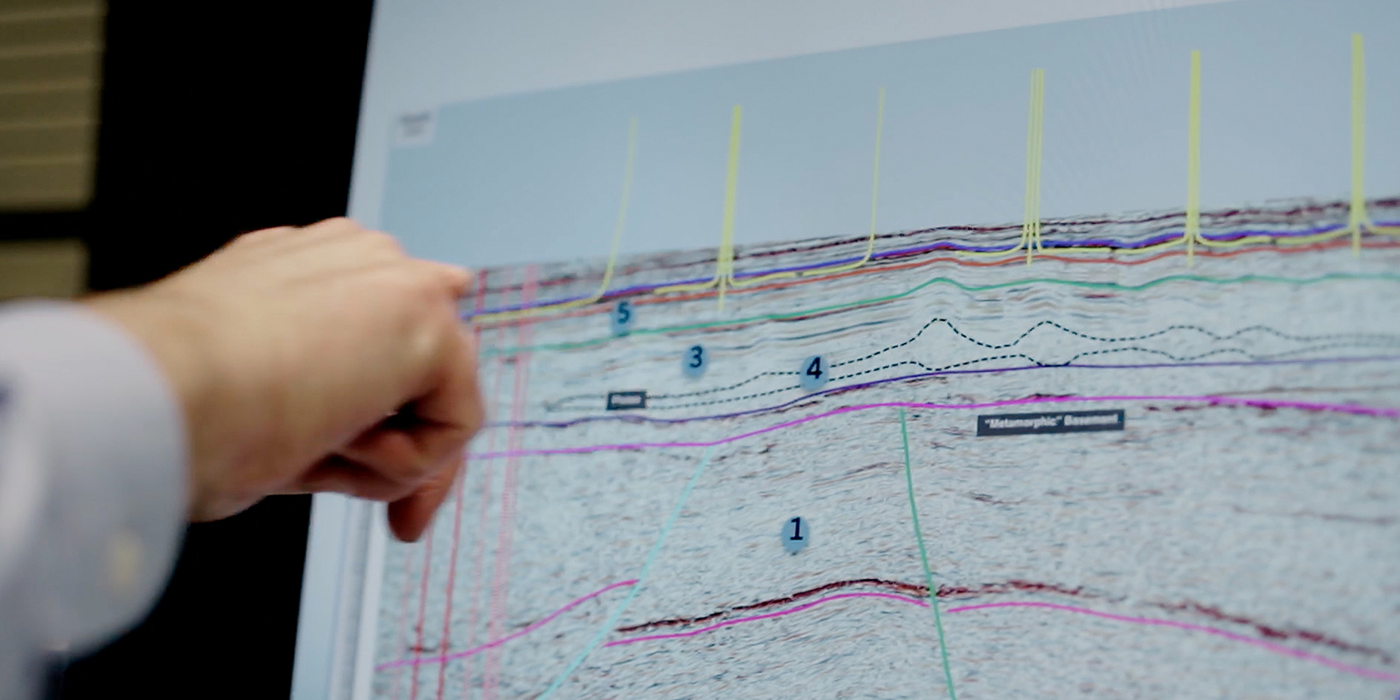
Proof of concept
2 tests carried out for this hackathon

Slide 6
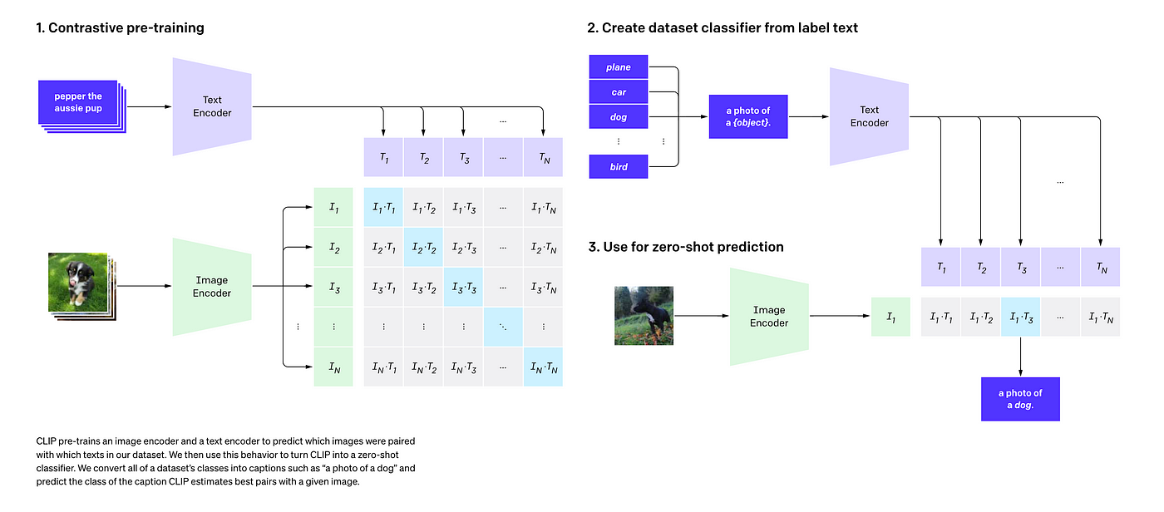
The technology behind – build a general purpose powerful embedding space
Based on CLIP model from OpenAI which is built on pairs (text, image)
We use pretrained model "ViT-B/32"
We build our own dataset to finetune "ViT-B/32"
The general idea is to build a common embedding space for all geoscience material (images, signals, log wells, textual descriptions)
Here only image (Visual Transformers) and text (Transformers) -> maximize cosine similarity

Slide 7
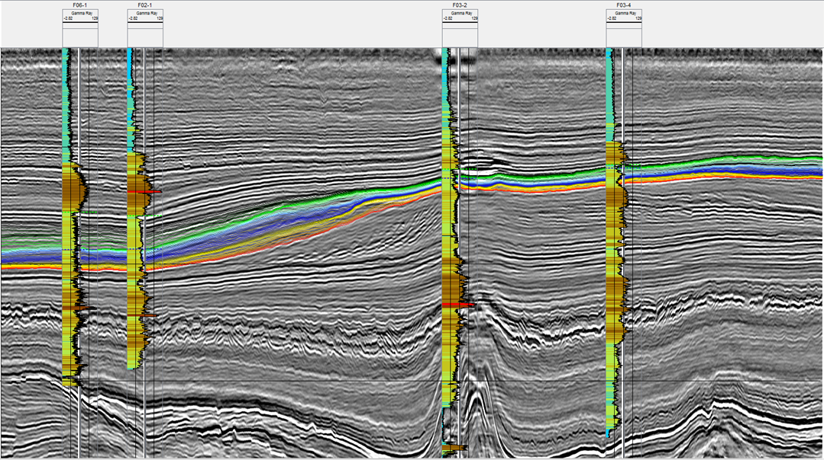

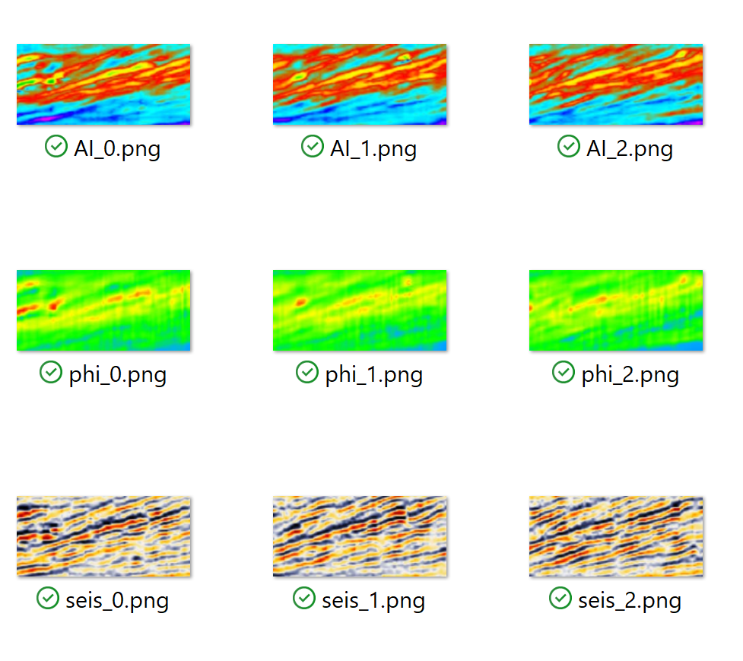
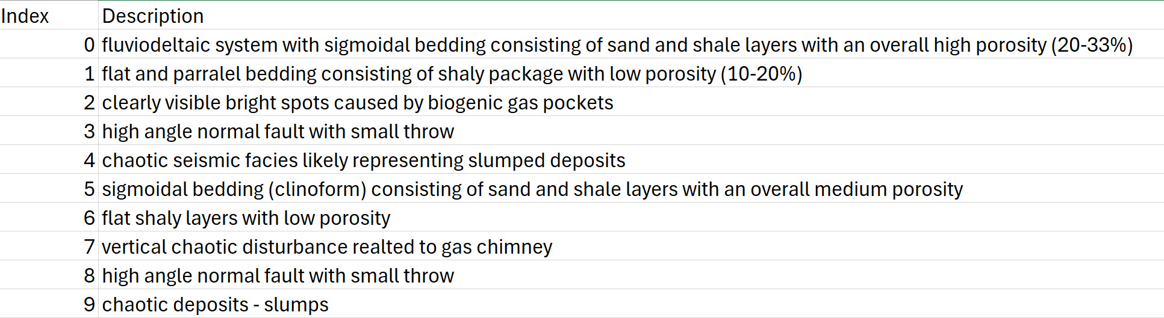
Dataset
Images taken from https://wiki.seg.org/wiki/F3_Netherlands 3D marine dataset
Only 10 examples but 3 modalities for each description

Slide 8
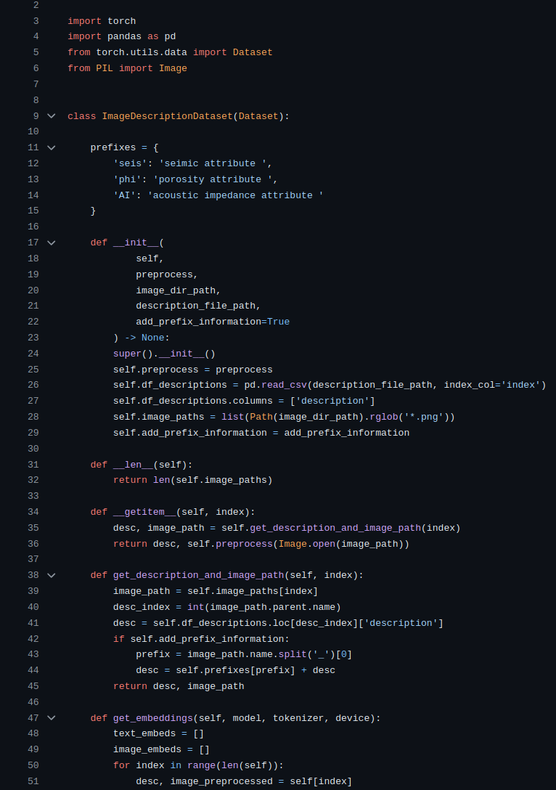
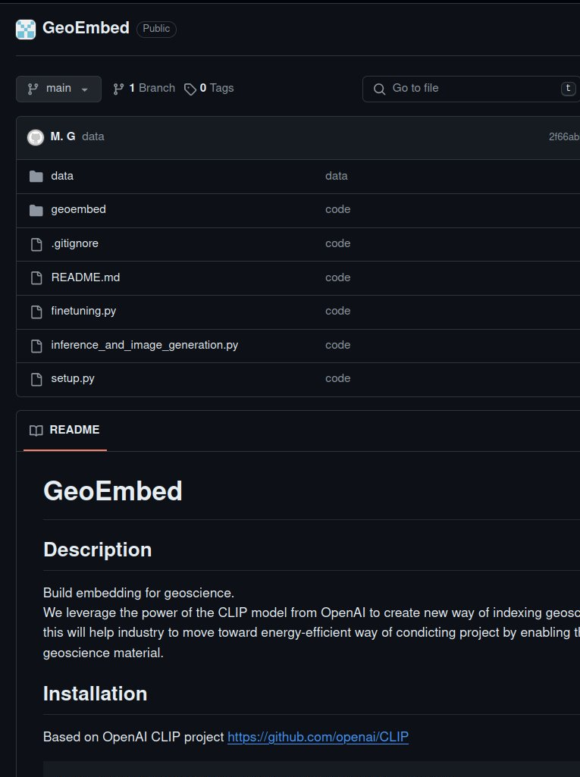
Code and data available
github.com/EAGE-Annual-Hackathon/GeoEmbed

Slide 9
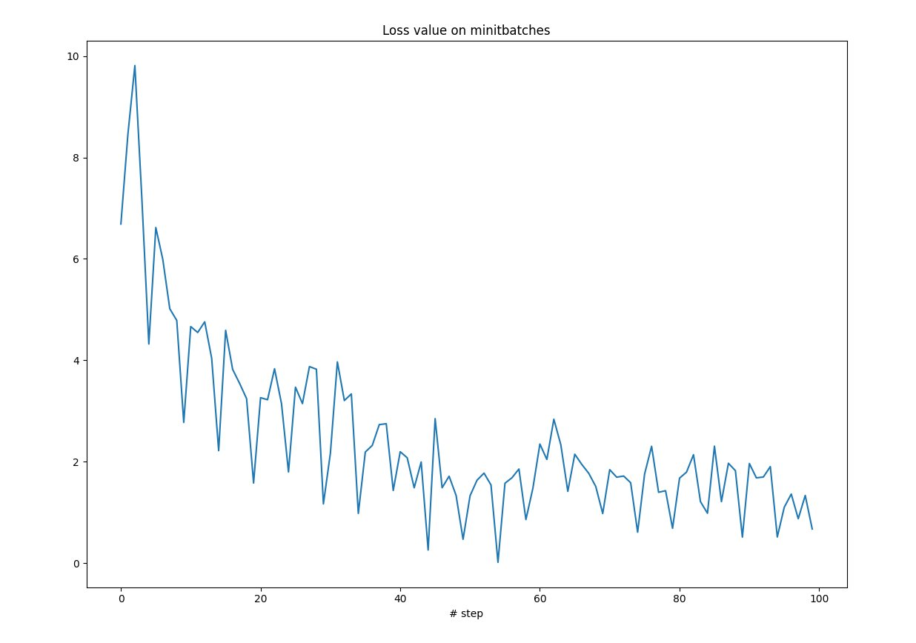
Training – model learns
Around 100 steps
Adam optimizer: learning rate of 5e-5
Batch of 10 pairs

Slide 10
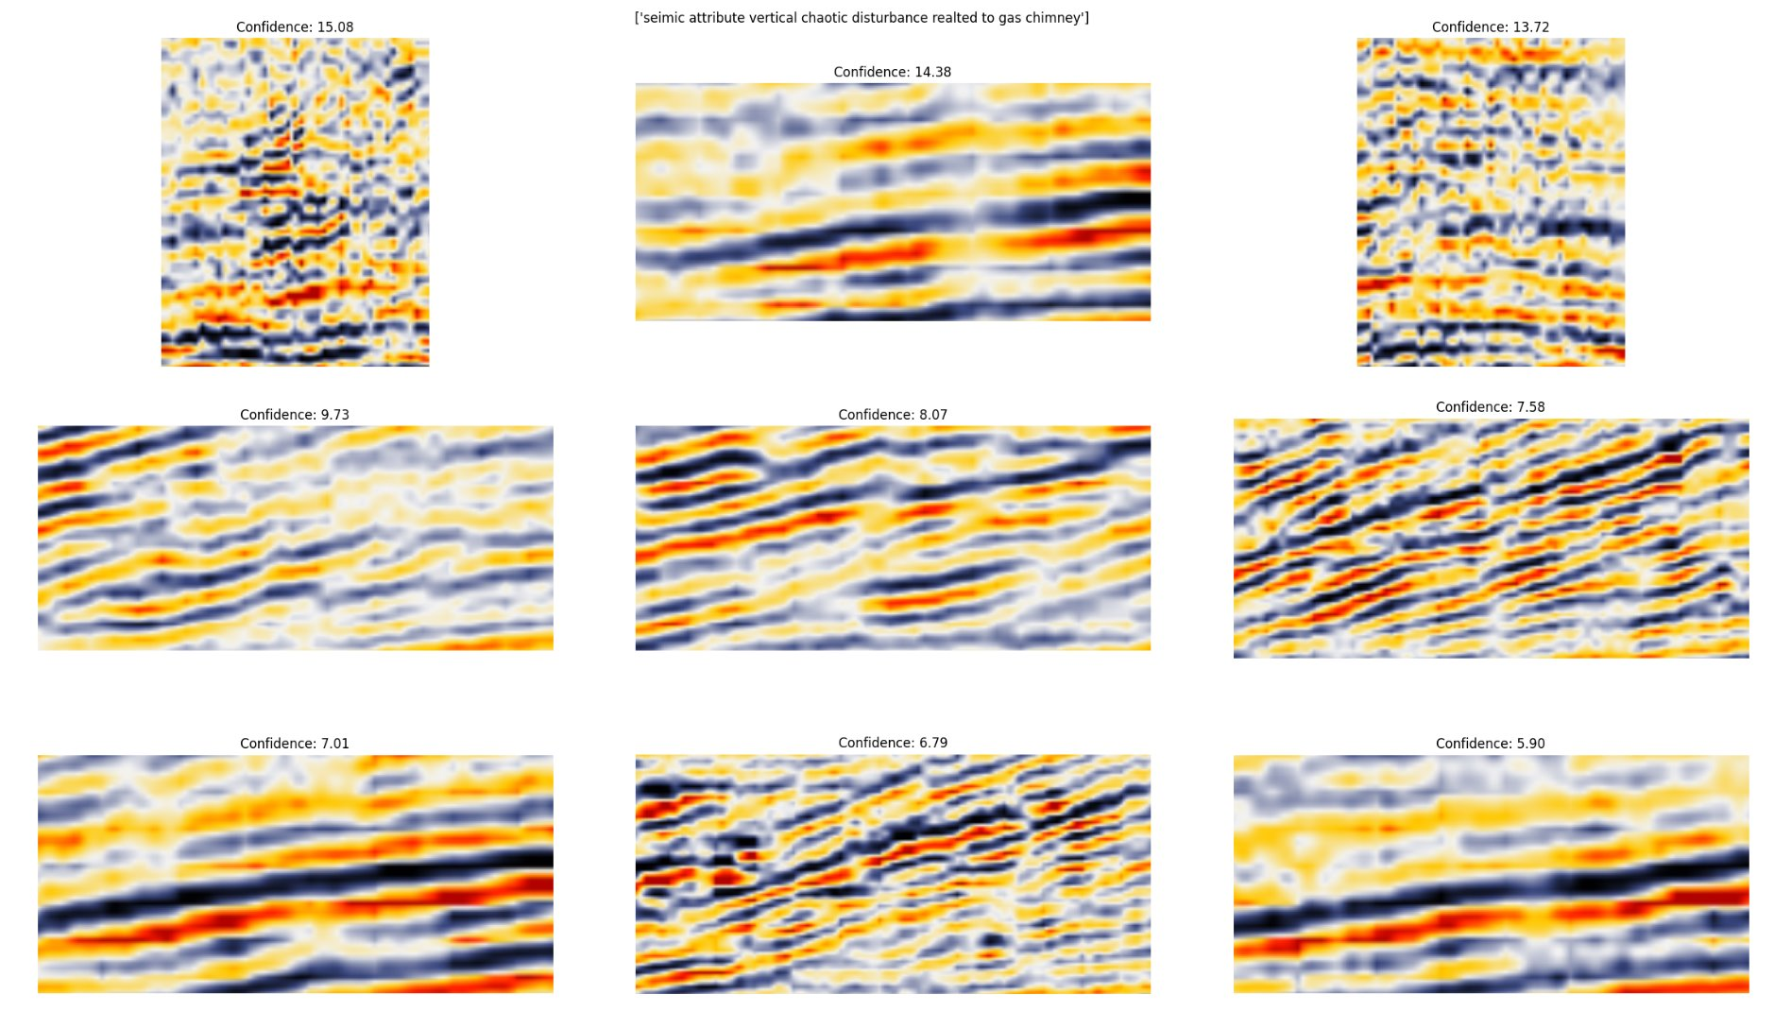
Test1: Results
INPUT:
Seismic attribute vertical chaotic disturbance related to gas chimney
Highest confidence

Slide 11
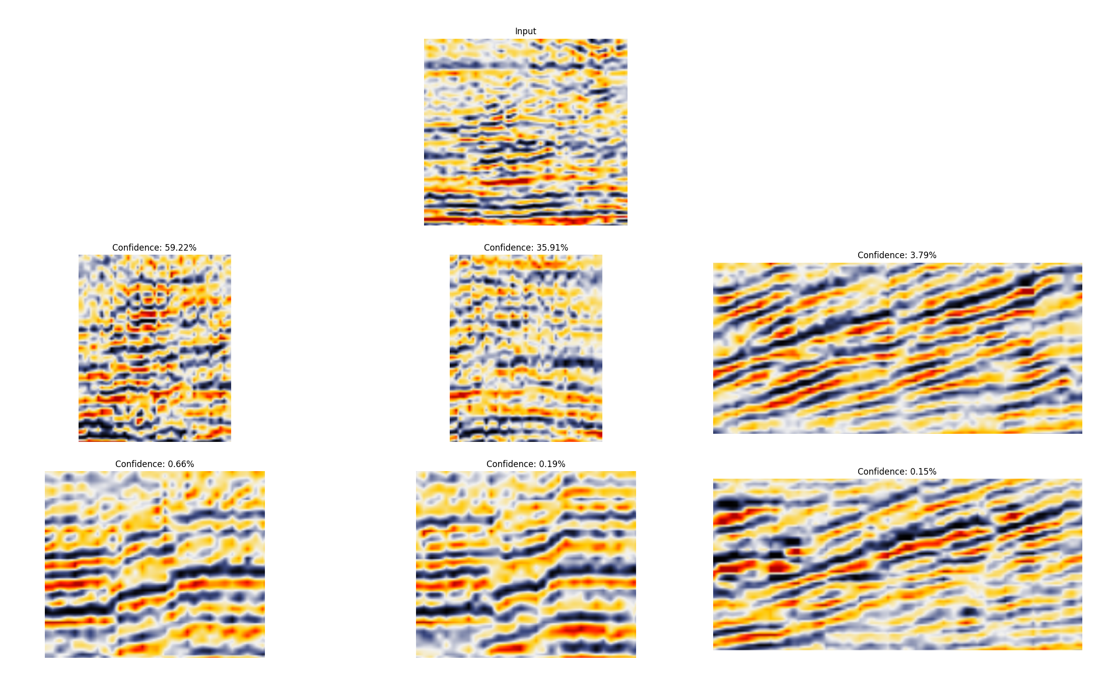
Test2: Results
INPUT:
Highest confidence

Slide 12
Conclusion & Way forward
Technical
Increase the dataset -> several hundreds
Build a strong validation methodology
Test other pretrained models
Integrate other modalities like well logs
To net-zero
Leverage historical data contained in all the available projects (even for training)
Move faster toward to solutions (more time-efficient and so more energy-efficient)
Only use finetuning (energy-efficient) (reuse already very good model build by big companies like OpenAI, Google, Nvidia, …)

Slide 13
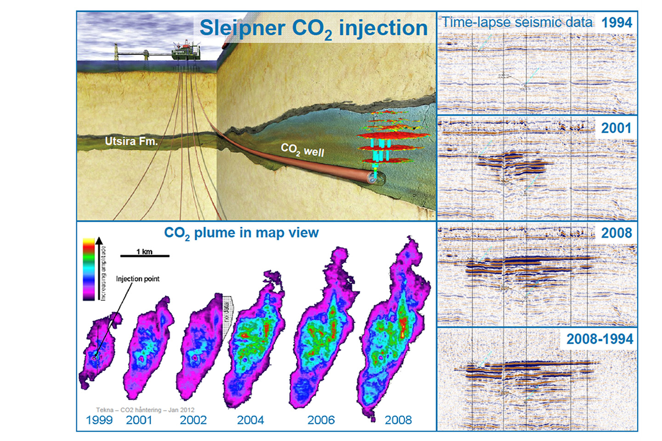
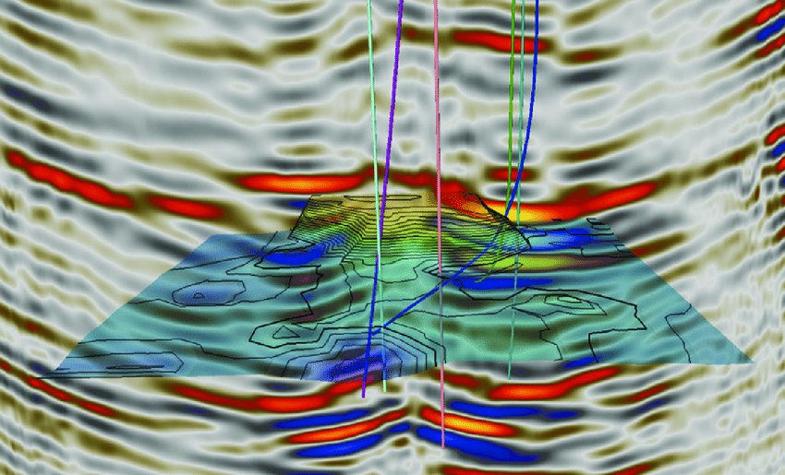
Some applications
CCUS
Well planning

Slide 14
Thanks!
Q&A
GeoEmbed team

